Slide 1
Take your education to the next level

Slide 2

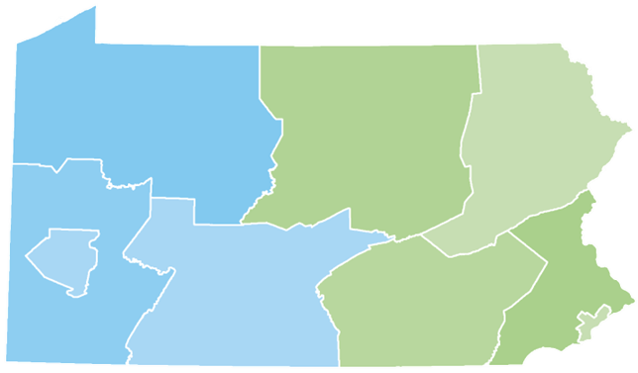
Your Presenter
Diona Brown
Higher Education Access Partner
PA Higher Education Assistance Agency (PHEAA)
Diona.brown@pheaa.org
Counties: Adams, Cumberland, Franklin, Fulton and York

Slide 3

Topics of Discussion
Financial Aid 101
  Financial Aid Basics
  Types & Sources of Aid
Federal & State Aid
Five Steps to Financial Aid
Applying for Aid
What Happens Next?
Final Thoughts
Questions

Slide 4

Financial Aid Basics
Financial Aid: financial assistance to help students pay the cost of an education at a post-secondary school.
Paying is the joint responsibility of the student and parent(s), to the extent possible
Eligibility criteria may apply in order to receive/maintain financial aid, such as:
  Students must maintain satisfactory academic progress
  Additional criteria may be required based on the type and source of aid
Students should play an active role in the process
  Talk with children about goals/plans (review educationplanner.org & mysmartborrowing.org)
  Take advantage of college fairs & school visits (ask about cost and available aid)
Some students may not qualify for all forms of aid
Must apply every year to be considered

Slide 5

Financial Aid Basics
Cost of Attendance(COA):
Costs that the student can expect to incur during the school year (direct + indirect costs)
Direct costs: billed by the school
Indirect costs: not included in bill but may be incurred
Student Aid Index (SAI)
A measure of a family’s financial strength , namely its ability to pay for college. The SAI is calculated from a federal formula using info collected from the Free Application for Federal Student Aid (FAFSA)
School costs include:
  Tuition and fees
  Room and board
  Books and supplies
  Transportation
  Miscellaneous living expenses
Financial Need = COA – SAI-OFA
OFA is estimated financial aid from non federal sources. Schools will determine need after reviewing financial aid applications.
Schools will create an award package based on need and available funding at their schools

Slide 6

Types of Financial Aid
Gift Aid (Free Money)
  Grants: aid, based on financial need and generally does not have to be repaid
    Student must complete financial aid paperwork to determine eligibility
    Looks at COA & SAI
  Scholarships: aid, usually based on merit, that generally does not have to be repaid. Most students must meet certain qualifications to receive and maintain scholarships.
    Academic & athletic
    Talent (music, art, etc.)
    Grades, religious, ethnic or cultural background
    Select criteria determined by scholarship organization(s)

Slide 7

Types of Financial Aid
Self-Help Aid
  Work Study: Student obtains job, often coordinated through the campus and/or State.
    Wages earned help cover the cost of attendance
    Not offered at all schools
  Student Loans: Borrowed money that must be repaid (with interest)
    Federal Direct Loans -Student’s Name
    Federal PLUS Loans -Parent’s Name
    Private/Alternative Student Loans – Varies amongst lender

Slide 8
Federal Programs
Pell Grant: 2023-24 max award $7,395*
  Max amount reviewed every year
Campus-based aid: amounts determined by Financial Aid Office (FAO)
  FSEOG………………up to $4,000
  Federal Work-Study…FAO determines
For most programs, student must be enrolled at least half-time.
  Must complete the FAFSA
* Goes to most financially needy students

Slide 9

Pennsylvania State Grant
PA State Grant: 2023-24 max award $5,750
Awarded to eligible PA residents who demonstrate financial need
Required: approved school/ approved program of study
Out of State schools in DE, MA, OH, WV, VT & DC: max $600
  Veterans: up to $800
Cost Tier | Minimum Award | Maximum Award
$0 - $12,000 | $500 | $3,059
$12,001 - $19,000 | $500 | $4,894
$19,001 - $29,000 | $500 | $5,260
$29,001 - $32,000 | $500 | $5,750

Slide 10
PA State Administered Programs
State Work-Study - job related to major
Blind or Deaf Beneficiary Grant
Educational Assistance Grant (EAP) – National Guard
PA Military Family Education Program (MFEP)
Chafee Education and Training Grant – co-administered with the PA Department of Human Services
Foster Ed Tuition Waiver
Postsecondary Educational Gratuity Program (PEGP)
Partnerships for Access to Higher Education (PATH)
Pennsylvania Targeted Industry Program (PA –TIP)
Ready to Succeed Scholarship (RTSS)
For details, visit PHEAA.org.

Slide 11
Financial Aid Made Simple
Look for FREE money first
Know your specific deadlines
Fill out the FAFSA
Compare schools financial aid offers carefully
Be sure you have the money you need
5 Steps to Financial Aid
a Step 1 Step 2 Step 3 Step 4 Step 5

Slide 12
Step 1: Look For Free Money First
National
  Most found on corporate websites, scholarship databases & HS guidance offices/webpages
  Lots of competition
Local & Regional
    Check with HS Guidance office/webpage
    Businesses, churches, local foundations, etc. (stay on the lookout)
    Less competition
Post-Secondary:
    Check the school’s financial aid & admissions pages on website
    Inquire with financial aid office about scholarships from alumni and endowment funds

Slide 13
Scholarship Search
Don’t miss out on FREE money!
Start Early and Search Often
Create an Academic Resume:
  Academic success
  Extra Curricular Activities
  Community Involvement/Volunteerism
Create an Essay(s)- Write an essay, free from errors, that can be tweaked based on individual scholarships (be creative)
Secure Letter of Recommendations early
Pay attention to deadlines and understand the terms
FastWeb.com
EducationPlanner.org
FinAid.org
BigFuture.Collegeboard.org
Scholarshipamerica.org

Slide 14


Step 2: Know Your Deadlines
Applications for Admission
Deadlines for Scholarships
  Institutions, Outside Sources
Free Application for Federal Student Aid (FAFSA)
  Available October 1 of Senior Year. This year the FAFSA is delayed until December.
  Schools have Priority Deadlines
    Don’t have to have applied or been accepted to list schools on FAFSA

Slide 15
PA State Grant Deadlines
May 1 – If you plan to enroll in a degree program or a college transferable program at a junior college or other college or university (excludes community colleges)
August 1 – If you plan to enroll in a community college; a business, trade, or technical school; a hospital school of nursing; or a 2-year program that is not transferable to another institution

Slide 16
Free Application for Federal Student Aid: FAFSA
All students who wish to be considered for financial aid must complete the form.
Complete the correct FAFSA (2023-2024 AY)
Can start FAFSA and save to complete at a later time
File as early as October 1 of student’s senior year in high school(this year delayed)
Plan to Attend College From | Submit the FAFSA From | Using Tax Information From
Jul 1, 2023 - Jun 30, 2024 | Oct 1, 2022 - Jun 30, 2024 | 2021
Jul 1, 2024 - Jun 30, 2025 | Dec 2023 - Jun 30, 2025 | 2022
Jul 1, 2025- Jun 30, 2026 | Oct 1, 2024 - Jun 30, 2026 | 2023

Slide 17
Create Your FSA ID Accounts
The student applying for aid and all contributors providing information on the FAFSA need to create an FSA ID at studentaid.gov/fsa-id.
Create 4 days prior to completing the FAFSA.
Legal signature for student and contributors.
Users without an SSN will be able to acquire an FSA ID.
Social Security Number
Username
Email Address
Password
Mobile Phone
Security Questions
Enable Two-Step Verification

Slide 18
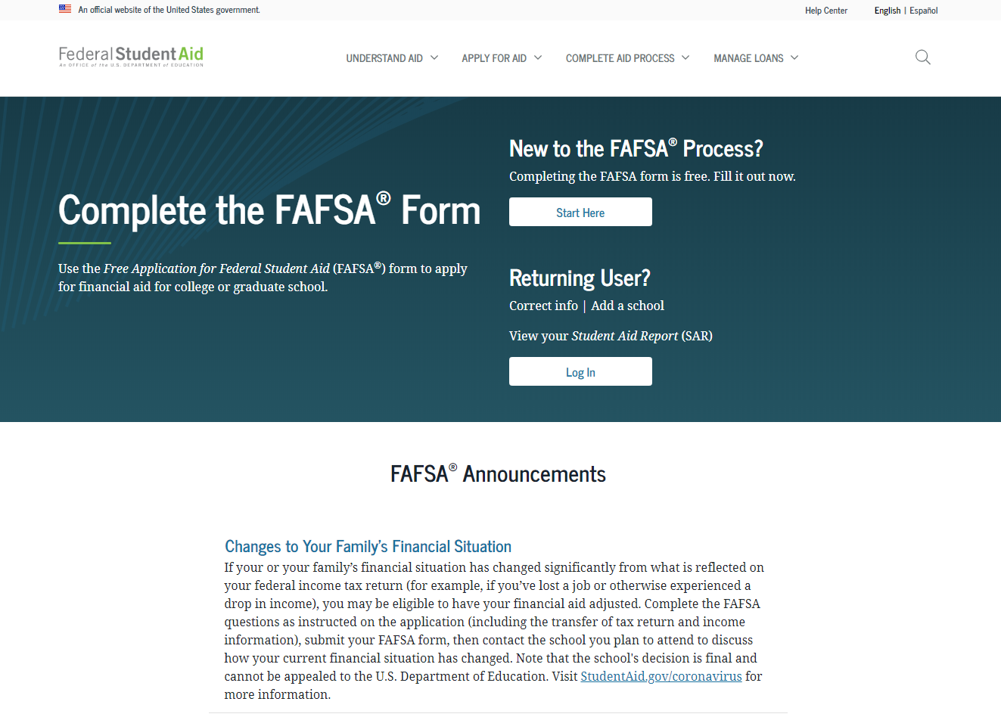

Free Application for Federal Student Aid (FAFSA)
PDF at studentaid.gov or
1-800-433-3243.
Studentaid.gov

Slide 19

2024-2025 FAFSA Prep
Information Needed for FAFSA
Social Security Numbers
Email Addresses (Not high school email address)
2022 Federal Tax Returns and W-2’s
Current bank statements and records of other investment accounts (as of the FAFSA filing date including farm value and value of small business)
Student & Contributor(s)
Federal Student Aid
Account FSA ID
Current Records of any stocks, bonds and other investments, including 529 for student for whom the FAFSA is being completed
Total child support received from the most recently complete calendar year

Slide 20
Step 3 : Fill out the FAFSA
FAFSA Steps – Dependent Student
Login – dependent student
Dependent Onboarding Steps
Verify Student Identity Information
Student Provides Consent
Personal Circumstances
Demographics
Financials
Colleges
Invite Parent Contributor
Signature
Student Section Complete Confirmation

Slide 21
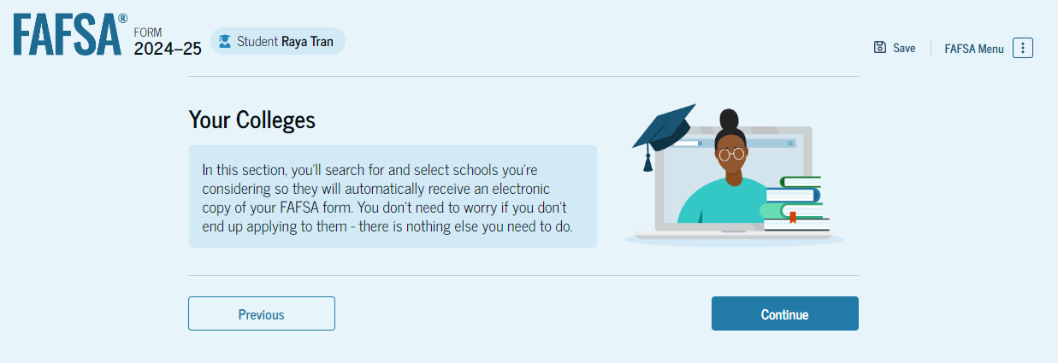
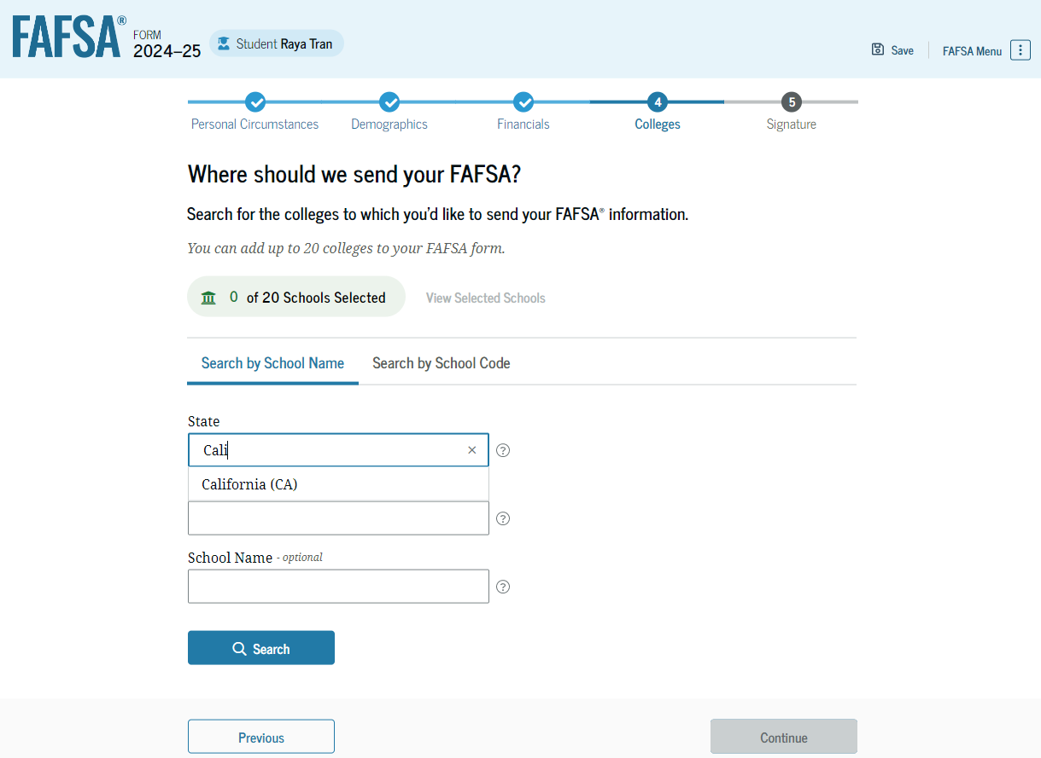
FAFSA – School Selection
List more than one!
Only schools that are listed will be able to see your FAFSA information.
Students can list up to 20 colleges at a time
Schools can be added or deleted at any time
Once the final school choice is made, students should update their PA State Grant record.

Slide 22
FAFSA Steps – Parent Contributor
Following link in email invite – Parent Log In
Parent Onboarding Steps
Verify Parent Identity Information
Parent Provides Consent
Demographics
Financials
Signature
Confirmation
Once all required data has been provided and all sections have been signed, any role can submit the FAFSA form

Slide 23
For Dependent Students, Who Reports Info on the 2024-25 FAFSA?
YES
Married parents living together
Biological parents living together
Divorced or separated parents:
  The parent that provided the most financial support to student over the past 12 months
  If equal, then student would invite the parent with the higher income and assets
Stepparent – If part of the student’s household
Adoptive parents
NO
Foster Parents
Legal Guardians
  By court order
Anyone else the student is living with

Slide 24

Consent
Applicant and any required contributor on the FAFSA must provide consent. They are consenting to:
Direct Data Exchange to import applicant, parent, parent spouse, and/or student spouse Federal Tax Information (FTI).
Redisclose FTI to state entities, institutions, and scholarship organizations.
If consent is not given student will not be eligible for need based aid.

Slide 25
What is considered an asset?
  Report the current value at time of filing the FAFSA:
  Cash
  Checking
  Savings
  Stocks
  Bonds
  Certificates of deposit (CD)
  Bitcoin
  Mutual funds
  Net value of real estate
Value of 529 accounts for the student owned by the parent(s) of a dependent applicant or owned by the student applicant
Child support received for the most recently complete calendar year
Net Worth of your businesses or for-profit agricultural operations.
  Not reported on FAFSA as an asset:
  Value of primary home
  Value of qualified retirement accounts
  Value of life insurance policies
  Value of personal property
  Value of 529 for any other family members (excluding applicant)

Slide 26

When Is A Student Automatically Considered “Independent”?
24 or older on Jan 1st of 2024
Married
Veteran (includes active-duty personnel)
Working on graduate level degree
Legally emancipated minor or in a legal guardianship with someone other than their parent or stepparent, as determined by a court in state of residence
Orphan, in foster care or ward of the court at
anytime since the student turned 13
Have legal dependents other than spouse
Student deemed homeless by proper authority
(PA State Grant status can be different)

Slide 27
Special Circumstances
If things change…
Professional Judgment exceptions can also be made for special circumstances due to income changes that are experienced before or after the FAFSA has been filed
Contact the financial aid office to discuss the situation
Separate forms for PA State Grant pheaa.org/forms

Slide 28
Student Unusual Circumstances
Prevents student from contacting parents or contacting parents would pose a risk to student.
A student may be experiencing unusual circumstances if they:
  Left home due to an abusive or threatening environment;
  Are abandoned by or estranged from their parents, and have not been adopted;
  Have refugee or asylee status and are separated from their parents, or their parents are displaced in a foreign country;
  Are a victim of human trafficking;
  Are incarcerated, or their parents are incarcerated, and contact with the parents would pose a risk to the student; or
  Are otherwise unable to contact or locate their parents, and have not been adopted.

Slide 29
After Filing
In a few days an email will be sent to the student regarding the processing of their FAFSA and their FAFSA Submission Summary.
Students should monitor the email account provided on the FAFSA and respond to requests from Federal Student Aid, PHEAA and the colleges.
Information will be shared with PHEAA and all college choices.

Slide 30
Financial Aid Notification
Official notification from school about financial aid, terms and conditions
Lists the type and amount of aid to be received
Describes what must be done to accept or
reject any aid
Discloses students' rights, responsibilities and academic requirements

Slide 31
Step 4: Comparing Packages
Cost | $20,000 | $30,000 | $50,000
SAI | $ 3,000 | $ 3,000 | $ 3,000
Need | $17,000 | $27,000 | $47,000
Free Money | $ 6,000 | $ 8,000 | $18,000
Loans | $ 5,500 | $ 7,000 | $ 8,000
Work-Study | $ 0 | $ 2,000 | $ 3,000
TOTAL AID | $11,500 | $17,000 | $29,000
Gap = (Cost – Aid) | $ 8,500 | $13,000 | $21,000
Actual Cont. = (Cost – Free $) | $14,000 | $22,000 | $32,000

Slide 32
Financial Aid Forms
Additional form that may need to be completed:
State Grant Form (SGF) through PHEAA
    Required for first -year students (addl. information may be required in subsequent years)
    Can link to the State Grant application from FOTWs confirmation page or may access at www.pheaa.org
Some Schools Require:
CSS Profile (College Scholarship Service) required by some postsecondary schools and scholarship organizations
  https://student.collegeboard.org/css-financial-aid-profile
  $25 for initial profile and $16 for each additional profile
  Fee waivers available for family income up to $100,000
Institutional Financial Aid Forms
  Internal forms specific to each school
  Required by some schools

Slide 33

Be a Smart Borrower
Exhaust all free financial aid options before borrowing student loans
Seek federal student loans before private student loans
Only borrower the amount needed (loans must be repaid)
Do your research!
MySmartBorrowing.org: An interactive, online tool created by PHEAA that helps students and families:
  Estimate career, salaries & college tuition
  View the impact of savings on overall cost
  Calculate loan repayment
  Avoid borrowing too much money
Select a
Career
Factor in Savings
Select a School
Get Results

Slide 34
Types of Federal Student Loans
Undergraduate Students
  Subsidized
  Unsubsidized
Graduate Students
  Unsubsidized
  Grad PLUS Loan
Parents
  PLUS Loan

Slide 35
Federal Direct Stafford Loan Borrowing Limits
Undergraduate Students |  |  | Graduate Students
Annual Limits | Dependent Students | Independent or dependent students whose parents are unable to borrow a PLUS Loan | Graduate or Professional Studies
1st Year | $5,500 Total No more than $3,500 may be subsidized | $9,500 Total No more than $3,500 may be subsidized | $20,500 each academic year Graduate / Professional students are no longer eligible for subsidized loans
2nd Year | $6,500 Total No more than $4,500 may be subsidized | $10,500 Total No more than $4,500 may be subsidized
3rd Year and beyond | $7,500 Total No more than $5,500 may be subsidized | $12,500 Total No more than $5,500 may be subsidized
Aggregate Limits | $31,000 Total No more than $23,000 may be subsidized | $57,500 Total No more than $23,000 may be subsidized | $138,500 Total No more than $65,000 may be subsidized

Slide 36

Student Loans
Federal Direct Loans
Federal PLUS Loans
Private Loans
Loan is in the student’s name
Max. borrowing limits
May receive a Direct Subsidized and/or Direct Unsubsidized loan
Fixed rate: 5.50%
Origination fee of 1.057% of the amount requested
Deferred payments
Must complete the FAFSA
Must complete entrance exam & MPN
Loan is in the parent’s name
Must meet credit requirements
  May apply with a credit worthy cosigner
  If denied, student may borrow additional unsubsidized amount
May borrower up to the COA minus any other aid
Fixed interest rate: 8.05%
Origination fee of 4.228%
Payments may be deferred
Student must complete the FAFSA
Loan is in the student’s name (cosigner is generally required)
Student or Cosigner must meet income & credit requirements
May borrower up to the COA minus any other aid
Variable or fixed interest rate
May have cosigner release clauses
Terms vary by lender
  Do your research
  Read the fine print

Slide 37

PA’s Low-Cost Way
to Pay for College!
Low, Fixed Rates
3.82 -7 .69%
1,2
^{APR}
Learn more at PHEAA.org/PAForward
1) Annual Percentage Rate (APR) Calculations – The lowest APR is based on the following assumptions: a loan of $10,000 made in a single disbursement, a student borrower who selected an Immediate Repayment Plan and a repayment term of 120 months, monthly payments of $100.87 and a final payment $78.29, a fixed periodic interest rate of 4.17%, and a total amount financed of $11,980.40. The student borrower in this sample qualified for a 0.25% Direct Debit benefit for the entirety of the repayment period and a 0.50% graduation benefit was applied 47 months into repayment. The highest APR is based on the following assumptions: a loan of $10,000 made in a single disbursement, a student borrower who selected a Fully Deferred Repayment Plan and a repayment term of 180 months, monthly payments of $117.93, a fixed periodic interest rate of 7.07%, and a total amount financed of $21,227.72. The student borrower received an in-school deferment of 46 months and a grace period of 6 months. The student borrower in this sample did not qualify for any interest rate discounts. These APRs are estimates and may differ from the actual rates received.
2) The provided rate range includes Undergraduate, Graduate, and Parent loans and may change based on loan type, loan term, repayment plan, and applicable discounts (not all discounts apply to all loan products). See individual loan programs for more specific information. PHEAA uses applicant credit scores to determine eligibility and interest rates. Higher credit scores may mean an applicant is offered a lower interest rate.
Applicants, including co-signers, are subject to credit qualifications, completion of an application and credit agreement, and verification of application information. PHEAA uses applicant(s) FICO score(s) to determine eligibility and interest rates. Higher credit scores may mean an applicant is offered a lower interest rate.
PHEAA reserves the right to discontinue all programs or benefits without prior notice.

Slide 38
What Can You Do Now?
Visit College Websites
Create FSA ID & Complete the FAFSA
Utilize Net Price Calculators
collegecost.ed.gov
Explore Scholarships
Estimate Federal Student Aid
studentaid.gov/aid-estimator
Talk About What is Affordable

Slide 39

Use Your Resources
PHEAA.org
EducationPlanner.org
MySmartBorrowing.org
YouCanDealWithIt.com
PHEAA toll free: 800-692-7392
Federal Student Aid Info Center: 800-433-3243
StudentAid.gov – The one-stop shop site for all financial aid information.
StudentAid.gov/FAFSA – Direct link to the FAFSA

Slide 40
Your Presenter
Diona Brown
Higher Education Access Partner
PA Higher Education Assistance Agency (PHEAA)
Diona.brown@pheaa.org
Counties: Adams, Cumberland, Franklin, Fulton, and York
Notes:
To be revised by each Access Partner

